Slide 1

How to rangify your code
Tina Ulbrich @_Yulivee_
ROSEN Technology and Research Center GmbH
Notes:
Hi and welcome to my talk, how to rangify your code
My name is Tina Ulbrich, I work for the Rosen Technology and Research Center.
My goal in this talk is to provide some examples that are a little more complex to show you how you can use ranges in real world code.

Slide 2
Talk Recommendations
Notes:
Bevor I start, I want to recommend some talks or YouTube videos around ranges
There will be a link to all those talks in the slides

Slide 3
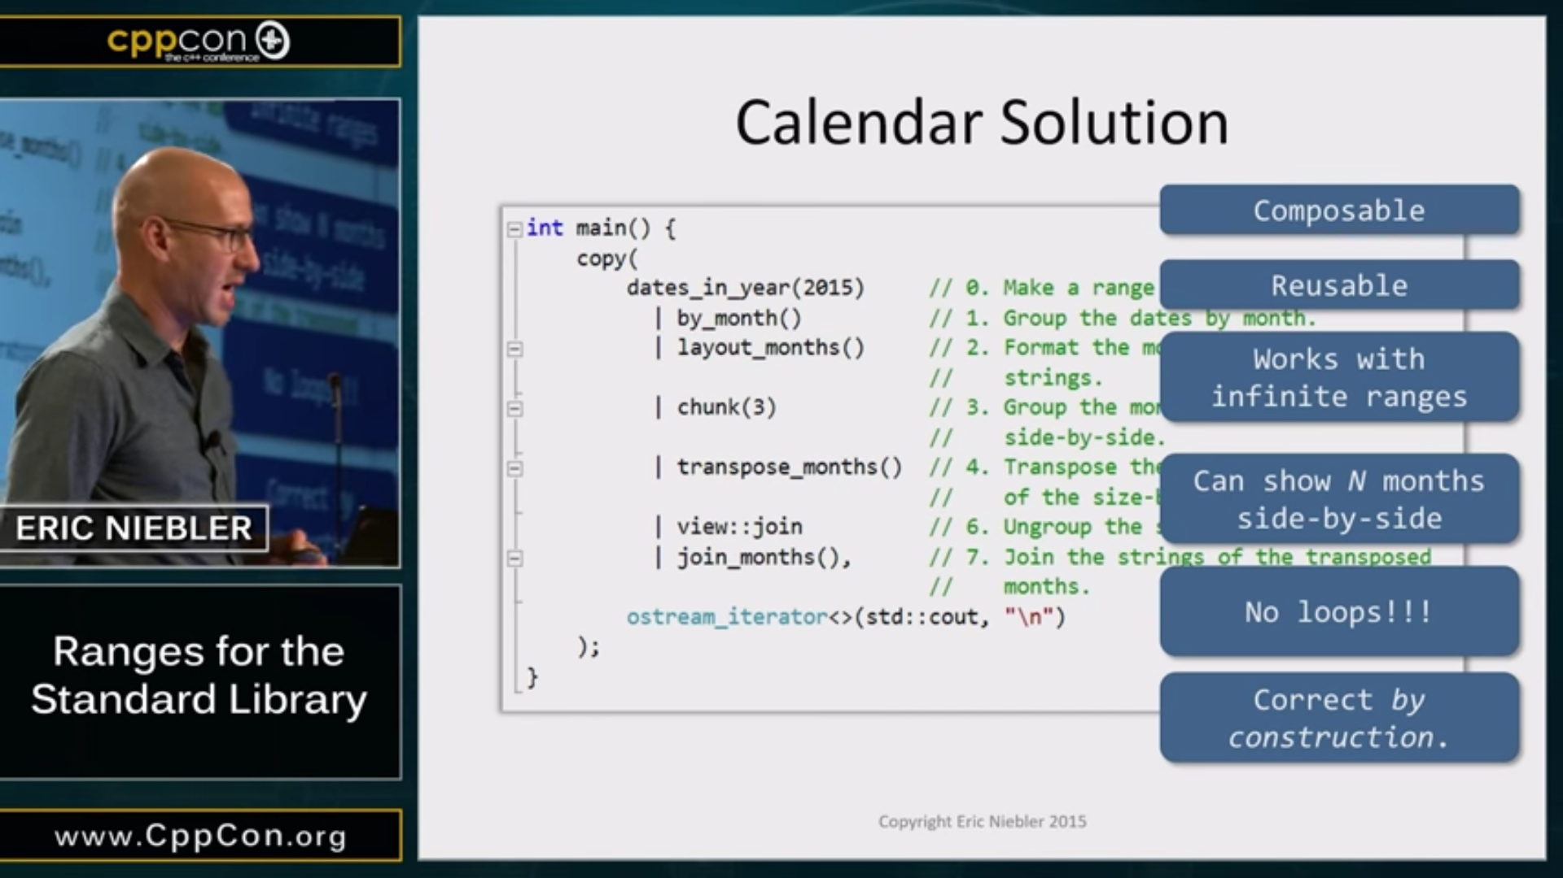
Talk Recommendations
Notes:
If you want to learn about ranges
Basically any ranges talk by Eric Niebler
Author of range-v3
Explains in depth how ranges work

Slide 4

Talk Recommendations
Notes:
Your place to start for standard ranges

Slide 5

Talk Recommendations
Notes:
great talk
also practice orientated with great exampes and very good background informations

Slide 6

Talk Recommendations
Notes:
- Go in depth into writing your own range adapters

Slide 7
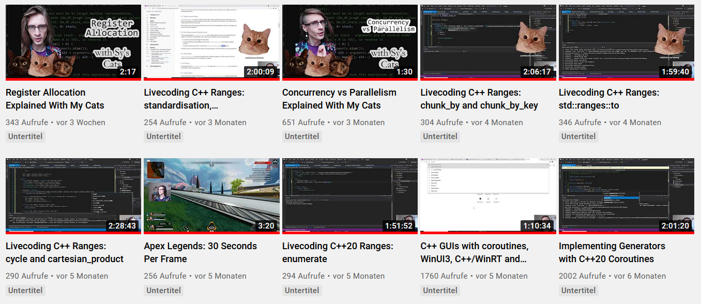
Talk Recommendations – Sy Brand
Notes:
How to write range views:
stride
transform_maybe
chunk_by
ranges to
enumerate

Slide 8
Libraries
Notes:
If you can‘t use C++20 yet or the standard library lacks some features for you, you can have a look at these libraries.

Slide 9
Libraries
range-v3
nanorange
TartanLlama/ranges
rangesnext
boost/range
Notes:
The range v3 librariy is the most extensive library for ranges support and the basis of the ranges support in the standard library. If you want to know more about this library I highly recommend Eric Nieblers talks
nanorange might be the second largest range library. It provides: concepts, range based algorithms, function object, projections and more
lots of range adaptors from Sys Youtube videos and more
Rangesnext provides the functions: ranges to, enumerate, product – cartesian product and a generator (todo ?)
boost ranges support range based algorithms and even a few range adaptors, using the pipe syntax

Slide 10
Rangify?
Notes:
So now that we covered some reccomendations and libraries, let‘s dive in
First: What do I mean?
a lot of people think of the pipe operator but it‘s more
but of course we focus on the pipe syntax a lot

Slide 11
ranges are algorithms are loops
Notes:
Ranges are algorithms are loops.
We have the tendency to think in loops first because that‘s what we learned first, we are doing them the longest so they are the most natural to us. A change in that already happend on the introduction of algorithms. It even got, and still gets, backlash from people, saying that they are harder to read and they don‘t trust the algorithm when they don‘t see how it‘s actually implemented. The same prejudice holds for ranges. The syntax is the most unfamiliar, especially compared to loops. It‘s way more a functional programming approach, where you describe what the code does and not how. I‘m convinced that once you get used to the syntax, reading and writing the code gets easier and easier.
The key is also to learn your algorithms to know, what is available.

Slide 12

Rangify?
const auto modify = [](const double elem) { return (elem * 2.0) / 10.0; };
const auto vec = std::vector{ 1.0, 2.0, 3.0 };
auto out = std::vector<double>(vec.size());
std::transform(vec.begin(), vec.end(), out.begin(), modify);
std::ranges::transform(vec, out.begin(), modify);
std::ranges::copy(vec | std::views::transform(modify), out.begin());
const auto out2 = vec | ranges::views::transform(modify) | ranges::to<std::vector>();
Notes:
Rangify also means using range based algorithms.
You might think that‘s not a huge change. We can just now ommit the begin and end. But it gives the option to better discribe intent rather than implementation details. It also limits the noise. And also, we can now use views in these algorithms.
So let‘s say you have a vector of >things< and you want to modify and store the result in a new vector
thousand ways of solving this
for loop, index based, iterator based or range based
standard library transform
ranges transform
copy with range adaptor transform
transform and ranges to
All of these little examples can seem very overengeneered. That‘s why I came up with more complex examples. I try to show as many different cases as possible.

Slide 13
Examples
Notes:
I‘ll start with some small examples that fit on one slide

Slide 14
Sliding mean
auto sliding_mean(const std::span<const double> rng)
{
auto out = std::vector<double>(rng.size() - 4);
for (size_t i = 2; i < rng.size() - 2; ++i)
{
out[i - 2] = mean(
std::array<double, 5>{ rng[i - 2], rng[i - 1], rng[i], rng[i + 1], rng[i + 2] });
}
return out;
}
auto sliding_mean(const std::span<const double> rng)
{
return rng
| ranges::views::sliding(5)
| ranges::views::transform(mean)
| ranges::to<std::vector>();
}
Notes:
Simplified version of real life code. This is as I found it! Of course the non range code can be improved, but thats not the point.
Mean takes a span → subrange can be converted to a span

Slide 15
Subtract mean
void subtract_mean(
const std::vector<double>& column_mean,
boost::multi_array_ref<double, 2> matrix)
{
for (auto row : matrix)
for (size_t i = 0; i < column_mean.size(); ++i)
row[i] -= column_mean[i];
}
void subtract_mean(
const std::vector<double>& column_mean,
boost::multi_array_ref<double, 2> matrix)
{
std::ranges::transform(std::span(matrix.origin(), matrix.num_elements()),
// matrix | ranges::views::join()
column_mean | ranges::views::cycle,
matrix.origin(),
[](const auto elem, const auto mean) { return elem - mean; });
}

Slide 16
Sum non defective values
struct data
{
bool is_defective;
int value;
};
auto sum_non_defective(const std::vector<data>& range)
{
auto sum = 0;
for (size_t i = 0; i < range.size(); ++i)
{
if (!range[i].is_defective)
{
sum += range[i].value;
}
}
return sum;
}

Slide 17
Sum non defective values
auto sum_non_defective(const std::vector<data>& range)
{
auto sum = 0;
for (size_t i = 0; i < range.size(); ++i)
{
if (!range[i].is_defective)
{
sum += range[i].value;
}
}
return sum;
}
auto sum_non_defective(const std::vector<data>& range)
{
return ranges::accumulate(range | std::views::filter(std::not_fn(&data::is_defective))
| std::views::transform(&data::value), 0);
}
Notes:
- Projection → „extract“ a data member from an element which is some class type; looks like a pointer to the member

Slide 18
Sum non defective values
auto sum_non_defective(const std::vector<data>& range)
{
auto sum = 0;
for (size_t i = 0; i < range.size(); ++i)
{
if (!range[i].is_defective)
{
sum += range[i].value;
}
}
return sum;
}
auto sum_non_defective(const std::vector<data>& range)
{
return ranges::accumulate(range | std::views::filter(std::not_fn(&data::is_defective)),
0, std::plus{}, &data::value);
}

Slide 19
Sum non defective values
auto sum_non_defective(const std::vector<data>& range)
{
return ranges::accumulate(range | std::views::filter(std::not_fn(&data::is_defective))
| std::views::transform(&data::value), 0);
}
auto sum_non_defective(const std::vector<data>& range)
{
return ranges::accumulate(range | std::views::filter(std::not_fn(&data::is_defective)),
0, std::plus{}, &data::value);
}

Slide 20
Index handling
auto index_handling(const std::vector<std::vector<size_t>>& index)
{
std::vector<size_t> out;
for (size_t i = 0; i < index.size(); ++i)
for (const auto idx : index[i])
if (idx != i)
out.push_back(idx);
return out;
}
auto index_handling(const std::vector<std::vector<size_t>>& index)
{
return ranges::view::enumerate(index)
| ranges::view::transform([](const auto& indices)
{
const auto& [i, idx_rng] = indices;
return idx_rng | ranges::view::filter([=](const auto idx) { return i != idx; });
})
| ranges::view::join
| ranges::to<std::vector>;
}

Slide 21
Complex
Example
Notes:
Now, for the last part of the talk, I prepared a more complex example

Slide 22
Hondt Method
party
1
party
2
party
3
votes
: 110
votes
: 85
votes
: 35
1
(1)
110 / 1 = 110
(2)
85 / 1 = 85
(6)
35 / 1 = 35
2
(3)
110 / 2 = 55
(4)
85 / 2 = 42.5
35 / 2 = 17.5
3
(5)
110 / 3 = 36.66
(7)
85 / 3 = 28.33
35 / 3 = 11.66
4
110 / 4 = 27.5
85 / 4 = 21.25
35 / 4 = 8.75
5
110 / 5 = 22
85 / 5 = 17
35 / 5 = 7
6
110 / 6 = 18.33
85 / 6 = 14.16
35 / 6 = 5.83
7
110 / 7 = 15.71
85 / 7 = 12.14
35 / 7 = 5
seats
: 3
seats
: 3
seats
: 1
Notes:
Also Jefferson method or the greatest divisors method
method for allocating seats in parliaments or proportional representation systems

Slide 23
Hondt Method – pre ranges / C++17
auto hondt_method(
const std::map<std::string, int>& votes_per_party,
const int total_number_of_seats)
{
}
C++17
Notes:
How I would most likely implement this
Make funktion

Slide 24
Hondt Method – pre ranges / C++17
party
1
party
2
party
3
votes
: 110
votes
: 85
votes
: 35
1
110 / 1 = 110
85 / 1 = 85
35 / 1 = 35
2
110 / 2 = 55
85 / 2 = 42.5
35 / 2 = 17.5
3
110 / 3 = 36.66
85 / 3 = 28.33
35 / 3 = 11.66
4
110 / 4 = 27.5
85 / 4 = 21.25
35 / 4 = 8.75
5
110 / 5 = 22
85 / 5 = 17
35 / 5 = 7
6
110 / 6 = 18.33
85 / 6 = 14.16
35 / 6 = 5.83
7
110 / 7 = 15.71
85 / 7 = 12.14
35 / 7 = 5
Notes:
First calculate quotients
Divisors: just count up to the number of seats
Calculate quotient and remember which quotients belong to which party

Slide 25
Hondt Method – pre ranges / C++17
auto hondt_method(
const std::map<std::string, int>& votes_per_party,
const int total_number_of_seats)
{
auto proportional_votes = std::vector<std::pair<std::string, double>>();
for (int i = 1; i < total_number_of_seats + 1; ++i)
{
for (const auto& [party, number_of_votes] : votes_per_party)
{
proportional_votes.push_back({ party, static_cast<double>(number_of_votes) / i });
}
}
}
C++17
Notes:
Decided on vector of pairs; could be a map or vector of structs
Could reserve size → size of map times number of seats → keep the noise down
Create divisors by having a loop from one to number of seats + 1
Second loop → deconstruct map elements
Save party and quotient

Slide 26
Hondt Method – pre ranges / C++17
party
1
party
2
party
3
votes
: 110
votes
: 85
votes
: 35
1
(1)
110 / 1 = 110
(2)
85 / 1 = 85
(6)
35 / 1 = 35
2
(3)
110 / 2 = 55
(4)
85 / 2 = 42.5
35 / 2 = 17.5
3
(5)
110 / 3 = 36.66
(7)
85 / 3 = 28.33
35 / 3 = 11.66
4
110 / 4 = 27.5
85 / 4 = 21.25
35 / 4 = 8.75
5
110 / 5 = 22
85 / 5 = 17
35 / 5 = 7
6
110 / 6 = 18.33
85 / 6 = 14.16
35 / 6 = 5.83
7
110 / 7 = 15.71
85 / 7 = 12.14
35 / 7 = 5
Notes:
Zwischenergebnisse aus Beispiel

Slide 27
Hondt Method – pre ranges / C++17
auto hondt_method(
const std::map<std::string, int>& votes_per_party,
const int total_number_of_seats)
{
auto proportional_votes = std::vector<std::pair<std::string, double>>();
for (int i = 1; i < total_number_of_seats + 1; ++i)
{
for (const auto& [party, number_of_votes] : votes_per_party)
{
proportional_votes.push_back({ party, static_cast<double>(number_of_votes) / i });
}
}
std::sort(proportional_votes.begin(),
proportional_votes.end(),
[](const auto& rhs, const auto& lhs)
{
return rhs.second > lhs.second;
});
proportional_votes.resize(total_number_of_seats);
}
C++17

Slide 28
Hondt Method
party
1
party
2
party
3
votes
: 110
votes
: 85
votes
: 35
1
(1)
110 / 1 = 110
(2)
85 / 1 = 85
(6)
35 / 1 = 35
2
(3)
110 / 2 = 55
(4)
85 / 2 = 42.5
35 / 2 = 17.5
3
(5)
110 / 3 = 36.66
(7)
85 / 3 = 28.33
35 / 3 = 11.66
4
110 / 4 = 27.5
85 / 4 = 21.25
35 / 4 = 8.75
5
110 / 5 = 22
85 / 5 = 17
35 / 5 = 7
6
110 / 6 = 18.33
85 / 6 = 14.16
35 / 6 = 5.83
7
110 / 7 = 15.71
85 / 7 = 12.14
35 / 7 = 5
seats
: 3
seats
: 3
seats
: 1

Slide 29
Hondt Method – pre ranges / C++17
auto hondt_method(
const std::map<std::string, int>& votes_per_party,
const int total_number_of_seats)
{
...
proportional_votes.resize(total_number_of_seats);
auto distribution = std::map<std::string, int>();
for (const auto& [party, number_of_votes] : votes_per_party)
{
const auto count = std::count_if(proportional_votes.begin(),
proportional_votes.end(),
[&](const auto& votes)
{
return votes.first == party;
});
distribution.insert({ party, static_cast<int>(count) });
}
return distribution;
}
C++17

Slide 30
auto hondt_method(const std::map<std::string, int>& votes_per_party, const int total_number_of_seats)
{
auto proportional_votes = std::vector<std::pair<std::string, double>>();
for (int i = 1; i < total_number_of_seats + 1; ++i)
{
for (const auto& [party, number_of_votes] : votes_per_party)
{
proportional_votes.push_back({ party, static_cast<double>(number_of_votes) / i });
}
}
std::sort(proportional_votes.begin(), proportional_votes.end(), [](const auto& rhs, const auto& lhs)
{
return rhs.second > lhs.second;
});
proportional_votes.resize(total_number_of_seats);
auto distribution = std::map<std::string, int>();
for (const auto& [party, number_of_votes] : votes_per_party)
{
const auto count = std::count_if(proportional_votes.begin(), proportional_votes.end(),
[&](const auto& votes)
{
return votes.first == party;
});
distribution.insert({ party, static_cast<int>(count) });
}
return distribution;
}
C++17
calculate proportional votes
sort and cut
count seats per party
Notes:
We will focus on all of these parts individually.
Rangify by using range_v3

Slide 31
Hondt Method – rangified
auto proportional_votes = std::vector<std::pair<std::string, double>>();
for (int i = 1; i < total_number_of_seats + 1; ++i)
{
for (const auto& [party, number_of_votes] : votes_per_party)
{
proportional_votes.push_back({ party, static_cast<double>(number_of_votes) / i });
}
}
C++17
auto seat_divisors = ranges::views::ints(1, total_number_of_seats + 1);
auto proportional_votes = ranges::views::cartesian_product(votes_per_party, seat_divisors)
C++20
Notes:
The hardest part of transforming this code is to know which algorithms we have and how to use them. But that‘s probably true for all new skills.
End val of ints is exclusive
Combine all elements from one range with all elements from another range
Name missleading → no multiplication → not even expects a function → view to combine all elements → equivalent to a nested for-loop

Slide 32
Hondt Method – rangified
{ { “party_1“, 110 }, 1 }, { { “party_2“, 85 }, 1 }, { { “party_3“, 35 }, 1 },
{ { “party_1“, 110 }, 2 }, { { “party_2“, 85 }, 2 }, { { “party_3“, 35 }, 2 },
{ { “party_1“, 110 }, 3 }, { { “party_2“, 85 }, 3 }, { { “party_3“, 35 }, 3 },
...

Slide 33
Hondt Method – rangified
auto proportional_votes = std::vector<std::pair<std::string, double>>();
for (int i = 1; i < total_number_of_seats + 1; ++i)
{
for (const auto& [party, number_of_votes] : votes_per_party)
{
proportional_votes.push_back({ party, static_cast<double>(number_of_votes) / i });
}
}
C++17
C++20
const auto divide_votes_by_seat_divisors = [](const auto& votes_and_divisor)
{
const auto& [party_and_vote, divisor] = votes_and_divisor;
return party_and_proportion{ party_and_vote.first,
party_and_vote.second / static_cast<double>(divisor) };
};
auto seat_divisors = ranges::views::ints(1, total_number_of_seats + 1);
auto proportional_votes = ranges::views::cartesian_product(votes_per_party, seat_divisors)
| ranges::views::transform(divide_votes_by_seat_divisors)
| ranges::to<std::vector>();
Notes:
Transform applies a function to all elements of a view or range
Lazy evaluation → view functions only invoked when the result is needed → here the to_vector function requests the results to save them in a vector
Mapping of function elements
Function above describes how, function below describes what
Might be harder to read in the beginning → not used to it

Slide 34
Hondt Method – rangified
std::sort(proportional_votes.begin(),
proportional_votes.end(),
[](const auto& rhs, const auto& lhs)
{
return rhs.second > lhs.second;
});
proportional_votes.resize(total_number_of_seats);
C++17
std::ranges::sort(proportional_votes, [](const auto& rhs, const auto& lhs)
{
return rhs.second > lhs.second;
});
proportional_votes.resize(total_number_of_seats);
C++20

Slide 35
Hondt Method – rangified
std::sort(proportional_votes.begin(),
proportional_votes.end(),
[](const auto& rhs, const auto& lhs)
{
return rhs.second > lhs.second;
});
proportional_votes.resize(total_number_of_seats);
C++17
std::ranges::sort(proportional_votes, [](const auto& rhs, const auto& lhs)
{
return rhs.proportion > lhs.proportion;
});
proportional_votes.resize(total_number_of_seats);
C++20
Notes:
Simple comparion, no longer need a lambda
In C++20: function and projection

Slide 36
Hondt Method – rangified
std::sort(proportional_votes.begin(),
proportional_votes.end(),
[](const auto& rhs, const auto& lhs)
{
return rhs.second > lhs.second;
});
proportional_votes.resize(total_number_of_seats);
C++17
C++20
std::ranges::sort(proportional_votes, std::greater(), &party_and_proportion::proportion);
proportional_votes.resize(total_number_of_seats);

Slide 37
Hondt Method – rangified
std::sort(proportional_votes.begin(),
proportional_votes.end(),
[](const auto& rhs, const auto& lhs)
{
return rhs.second > lhs.second;
});
proportional_votes.resize(total_number_of_seats);
C++17
C++20
proportional_votes |= ranges::actions::sort(std::greater(),
&party_and_proportion::proportion);
proportional_votes.resize(total_number_of_seats);

Slide 38
Hondt Method – rangified
std::sort(proportional_votes.begin(),
proportional_votes.end(),
[](const auto& rhs, const auto& lhs)
{
return rhs.second > lhs.second;
});
proportional_votes.resize(total_number_of_seats);
C++17
C++20
proportional_votes |= ranges::actions::sort(std::greater(),
&party_and_proportion::proportion);

Slide 39
Hondt Method – rangified
auto distribution = std::map<std::string, int>();
for (const auto& [party, number_of_votes] : votes_per_party)
{
const auto count = std::count_if(proportional_votes.begin(), proportional_votes.end(),
[&](const auto& votes)
{
return votes.first == party;
});
distribution.insert({ party, static_cast<int>(count) });
}
C++17
return votes_per_party
| ranges::views::keys
| ranges::views::transform(count_seats_per_party(proportional_votes, total_number_of_seats))
| ranges::to<std::map>();
C++20
Notes:
Getting keys → name of the parties → transform the names of the parties → lambda with the party as argument
Also need proportional votes and num seats
Function that returns a lambda → lambda gets calles by transform

Slide 40
Hondt Method – rangified
auto calculate_number_of_seats(
const std::vector<party_and_proportion>& proportional_votes,
const int total_number_of_seats,
const std::string_view party)
{
return ranges::count_if(proportional_votes | ranges::views::take(total_number_of_seats),
[&](const auto& party_and_votes)
{
return party_and_votes.party == party;
});
}
auto count_seats_per_party(
const std::vector<party_and_proportion>& proportional_votes,
const int total_number_of_seats)
{
return [&, total_number_of_seats](const auto& party)
{
const auto seats =
calculate_number_of_seats(proportional_votes, total_number_of_seats, party);
return std::pair{ party, seats };
};
}
C++20

Slide 41
Hondt Method – rangified
auto hondt_method(
const std::map<std::string, int>& votes_per_party,
const int total_number_of_seats)
{
auto seat_divisors = ranges::views::ints(1, total_number_of_seats + 1);
auto proportional_votes = ranges::views::cartesian_product(votes_per_party, seat_divisors)
| ranges::views::transform(divide_votes_by_seat_divisors)
| ranges::to<std::vector>();
proportional_votes |= ranges::actions::sort(std::greater(),
&party_and_proportion::proportion);
return votes_per_party
| ranges::views::keys
| ranges::views::transform(count_seats_per_party(proportional_votes,
total_number_of_seats))
| ranges::to<std::map>();
}
C++20
Notes:
https://godbolt.org/z/h53ne4b78

Slide 42
Performance

Slide 43
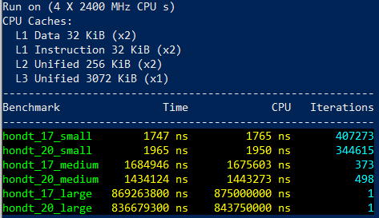
Performance Hondt Method
Notes:
quickbench: not working because range v3 version 0.3.0 -> current 0.11.0
Google benchmark for results
Bevor benchmarking I did a little improvement to the C++17 code and reserved the size for the vector
Small: as shown in slides: 3 parties, 7 seats
Medium: 15 parties, 700 seats
Big: 60 parties, 70.000 seats

Slide 44
Performance Hondt Method

Slide 45
Performance Hondt Method
Notes:
Please not that we moved to microseconds here

Slide 46
Performance Hondt Method
Notes:
Here it‘s milliseconds
So all in all, it doesn‘t make too much of a difference. The numbers are quite close
I didn‘t do an in depth analysis of the two solutions trying to optimize both of them. I just mostly took them as they are.
I know both of them have some potential for improvement so I may leave it to the next version of this talk to explore them.
Also, I complare the performance of the standard library to the range-v3 library here. So those numbers won‘t help you to find out the performance of the standard ranges. Please let me know if you are interested in that and I will try to implement the missing standard functions as close to the standard as possible and measure performance again.

Slide 47
Summary
Notes:
there are lots of great talks about ranges out there
also there are many libraries you can use, most complete is range v3
not every range based code uses the pipe syntax
the key to rangify code is to know the available algorithms
analyze your loops and find the algorithm that describes the loop
Once you get used to this way of thinking, it gets easier
Performancewise it can go both ways and if performance is an issue for you, you‘ll have to benchmark
We are using a combination of standard ranges and self written range adaptors, since standard ranges still lack a lot of features. But it provides a framework to create your own views.
We are free to use ranges in new code and change existing code to ranges.

Slide 48
Questions?
Tina Ulbrich @_Yulivee_
ROSEN Technology and Research Center GmbH
Notes:
Thank you for your attention
Do you have any questions?

Slide 49
Talks
https://www.youtube.com/c/SyBrandPlusCats/videos
https://youtu.be/YWayW5ePpkY
https://youtu.be/d_E-VLyUnzc
https://youtu.be/d9qDEEJFwNc
https://youtu.be/mFUXNMfaciE

Slide 50
Libraries
https://en.cppreference.com/w/cpp/ranges
https://github.com/cor3ntin/rangesnext
https://github.com/tcbrindle/NanoRange
https://github.com/TartanLlama/ranges
https://github.com/ericniebler/range-v3
https://www.boost.org/doc/libs/1_75_0/libs/range/doc/html/index.html

Slide 51
Resources
https://en.wikipedia.org/wiki/D%27Hondt_method
https://en.cppreference.com/w/cpp/ranges
https://ericniebler.github.io/range-v3/
https://github.com/cor3ntin/rangesnext

